Slide 1
AN EFFICIENT AND PRIVACY-PRESERVING BIOMETRIC MECHANISM IN CLOUD COMPUTING
M.Sai Tanuja
k.Sasi bindu
K.Malleswari
P.Naga durga
K.Sri latha

Slide 2

Introduction:

Slide 3
Abstraction:
Biometric identification has become increasingly popular in recent years. We propose an efficient and privacy preserving outsourcing scheme.
To execute biometric identification the data base owner encrypts the query data and submits it to the cloud.
The cloud performs identification operations on the encrypted datadase and returns the results to the database owner.

Slide 4
Existing system:
Recently some biometric schemes have been proposed.
Face recognition method is designed by measuring the similarity b/w sorted index numbers.
Finger code identification based on Homomorphic encryption technique.
Iris scan it is computationally infeasible for a malicious user to impersonate as an honest user.
To reduce the efficiency Evans proposed a novel protocol
which reduces the identification time.

Slide 5
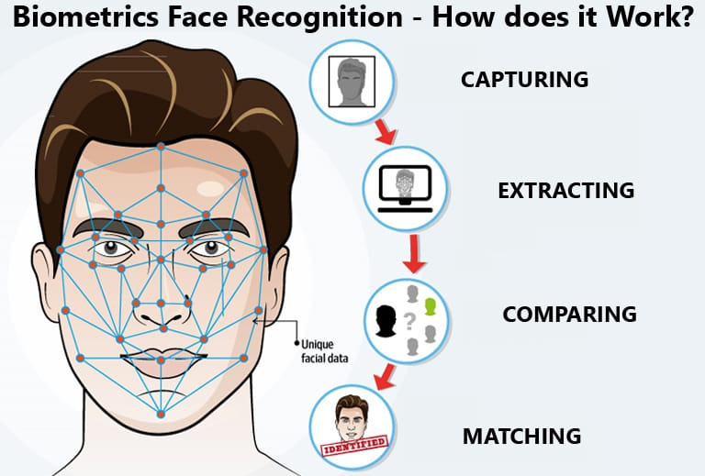
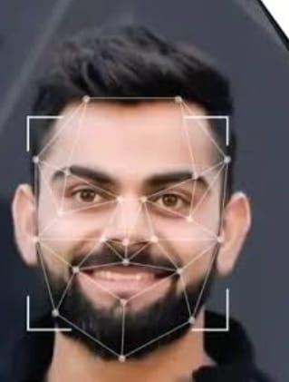
Face Recognition:

Slide 6

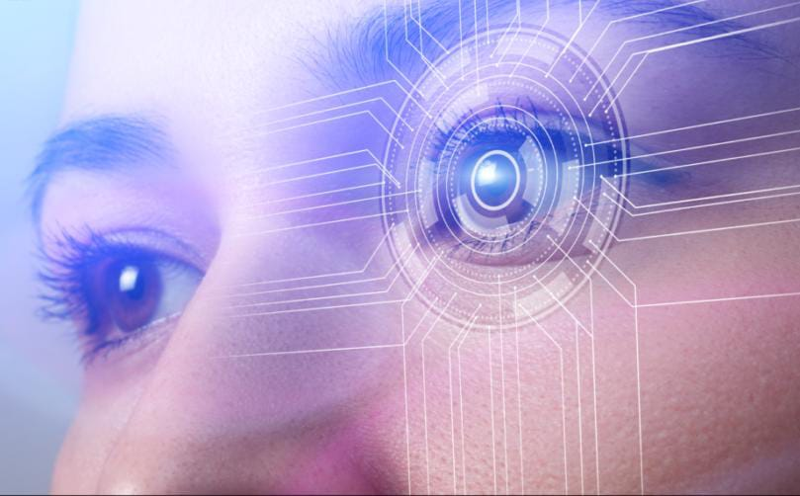

Slide 7
Proposed system:
We propose a solution that uses homomorphic encryption. Secure multi-party computation is also used.
Identification is performed on encrypted data. This preserves privacy and maintains efficiency.
Homomorphic Encryption
enables computation on encrypted data.
Secure Multi-party Computation
Protects data during processing.
Encrypted identification
Performs matching without decryption
1
2
3

Slide 8
Advantages
Can resist the collusion attack launched by the users.
Attackers can only observe the encrypted data stored in the cloud. In order to avoid the well-known cipher text-only attack.
Disadvantages
Data collection and storage challenges.
Lack of standardization.

Slide 9
System Requirements
H/w system configuration:-
RAM -4GB
Processor Pentium - IV
Hard disk – 20GB
S/w Requirements:-
Operating system – Windows
Coding language – Java
Front End – J2EE
Back End – My Sql

Slide 10


